Slide 1
MVP – Anomalous Trade Detection
Oracle
January 2023

Slide 2
Team Thunderbolts
Core Team
Gnana Venus Lazarus
Divya Gaurava
Divyansh Acharya
Jairaj Pillai
Samruddhi Borate
Sanket Patil
Tanmay Kharkar
Support & Guidance
Aniket Mhala
Aryaroop Pal

Slide 3
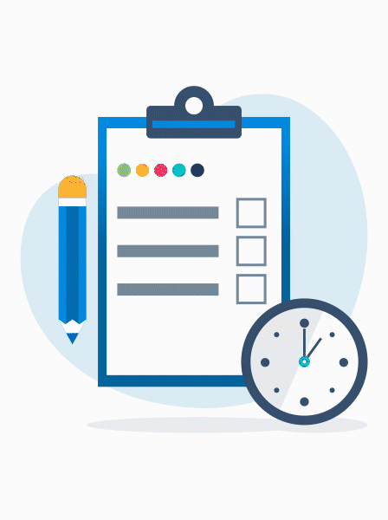
Agenda
“What is a Wash Trade?”, Problem Statement & Solution
OCI Services and Technologies used
Reference Architecture & MVP Architecture
Demo & MVP Snapshots
Notes:
Here's the agenda of today's presentation,
First we'll understand what a wash trade is and how it's executed
Then we'll look at the problem statement, understand why we need a RATD system
Then we'll look at what solution we've formed for the said problem
Quick look at the MVP architecture and then the standing of our use case with other services in the trading scenario
Then A small yet simple guide for you to determine costs for deploying this project
Then a look at all the new and unique benefits that our cloud platform provides against the competitors
And finally a demonstration of the whole project.
So I'll give the floor to Divya to begin this presentation.

Slide 4
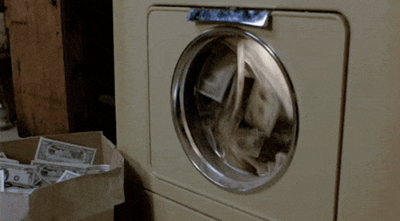
What is a Wash Trade?
A wash trade is a type of anomalous trade & a form of market manipulation in which an investor simultaneously sells and buys the same financial instruments to create misleading & artificial activity in the marketplace.
Here, an investor will buy & sell(or vice-versa) the same quantity of stock in a very short interval of time.
Notes:
Thank you Jairaj! Now we will see what is wash trade, so basically wash trade is an illegal activity in which a trader buys and sells the same security, either within a short period of time or on a separate exchanges, in order to increase the trading volume or the price of that security like it is used to generate fake volumes for a stock and pump up its price. for example: a trader and a broker can collaborate to buy and sell any stock rapidly. so that someone can take advantages of that and put money into that stock and after getting the profit, , the trader can short the stock, so this is the case of anomalous activity because they all Intentionally increased the valuation for their own profit.

Slide 5

Problem Statement
Why do Financial Regulatory bodies need an Anomalous Trade Detection System?
Wash trades mislead the rest of the market about the true level of demand, distort prices, and entice others to trade on fake information. If not detected, could cause major instability in the stock market.
Also, if not detected and reported efficiently, could potentially cause a rise in the frequency of anomalous activity, hence leading to critical financial losses.
Notes:
As we saw, Wash trade is an illegal activity and can be extremely damaging
to the proper functioning and integrity of capital markets as it can
mislead the rest of the market about the true level of demand, distort
prices and entice others to trade on fake information.
So, it’s necessary to detect and report the wash trades within a short
period after their generation.
For this, me and my team have built a solution in OCI.
Now, Tanmay will brief about the solution and the OCI services
in the next couple of slides.
Over to you Tanmay...

Slide 6

Solution – What can be done about these “Wash Trades”?
The aim is to create a cloud-native solution for the accurate detection of anomalous trades & send email containing the details of said trades to concerned parties, accordingly.
Notes:
As we saw, Wash trade is an illegal activity and can be extremely damaging
to the proper functioning and integrity of capital markets as it can
mislead the rest of the market about the true level of demand, distort
prices and entice others to trade on fake information.
So, it’s necessary to detect and report the wash trades within a short
period after their generation.
For this, me and my team have built a solution in OCI.
Now, Tanmay will brief about the solution and the OCI services
in the next couple of slides.
Over to you Tanmay...

Slide 7


OCI Services and Technologies used
OCI Object Storage
OCI Streaming
OCI Data Integration
OCI Data Flow
Spark Streaming
Python
PySpark
OCI Service Connector Hub
Notes:
The OCI Streaming service provides a fully managed, scalable, and durable solution for ingesting and consuming high-volume data streams in real-time.
This is the place where all of the trade stream is consumed continuously.
OCI Data Integration is a service multi-tenant service. We particularly use Data Integration to automate the runs of our Batch Data Flow Application, so it can
work in tandem with OCI Streaming and process data continuously.

Slide 8
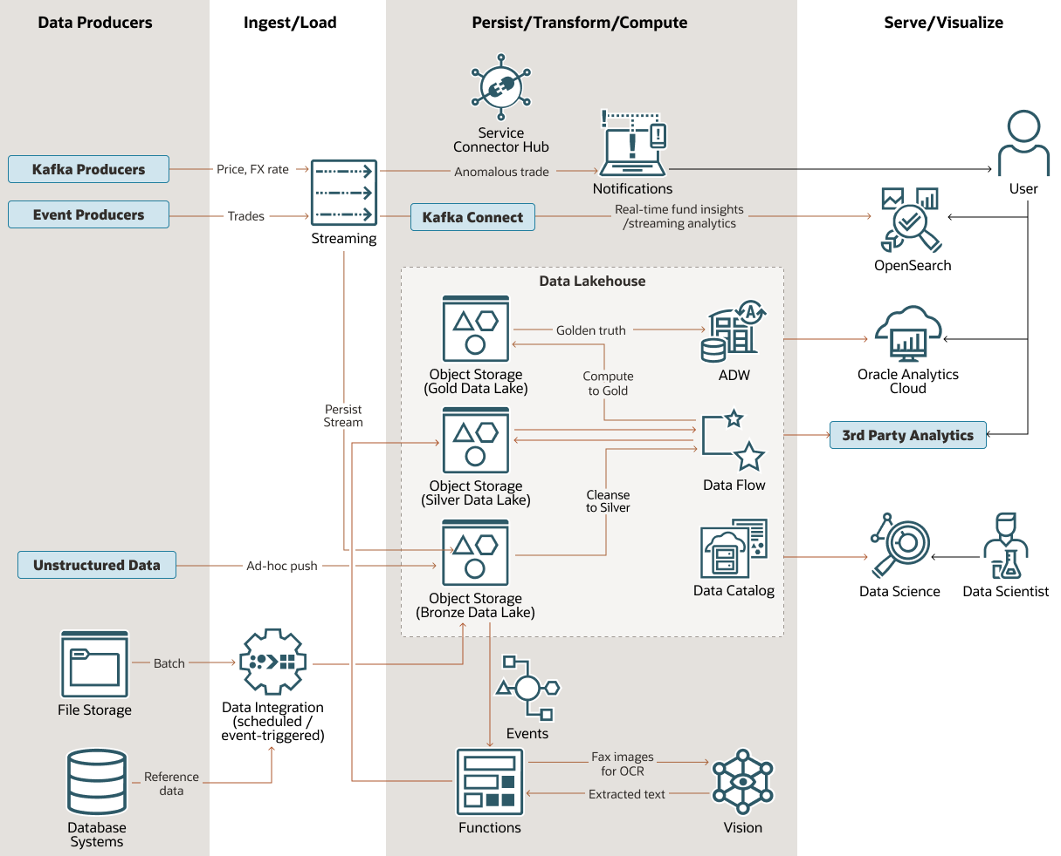
Reference Architecture-
Where we take inspiration from
Ref. Link- Design a Modern Data Platform for Financial Workloads (oracle.com)
Copyright © 2023, Oracle and/or its affiliates | Confidential: Restricted
05-01-2023

Slide 9
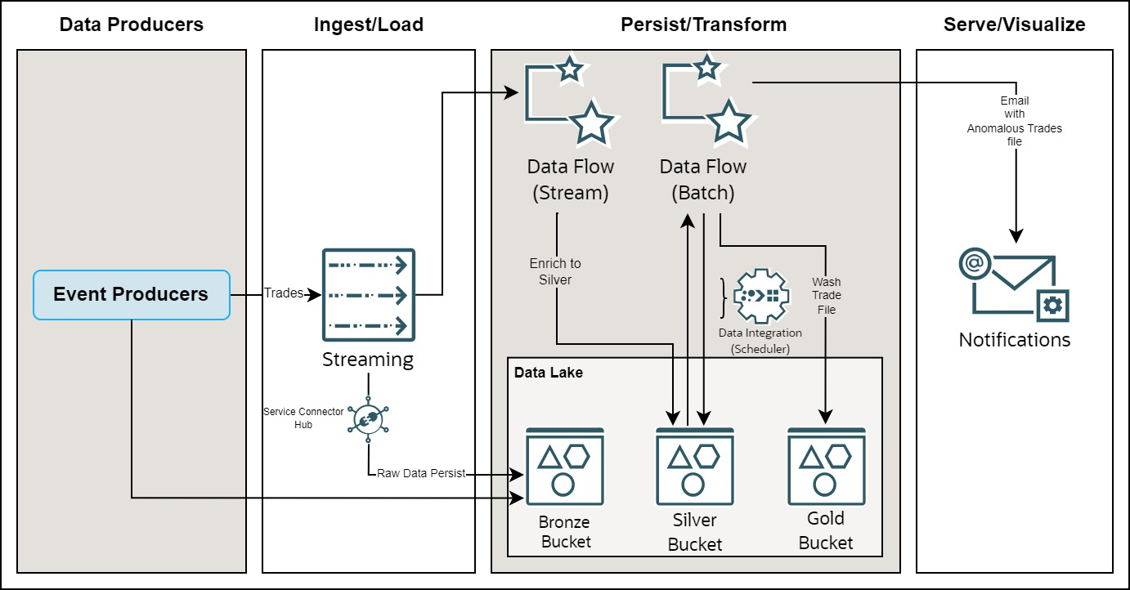
Anomalous Trade Detection MVP Architecture
Notes:
Thank you, Divya, starting off the architecture we have trade data coming in as a stream of trades from a python code called trade producer which produces stream data to OCI streaming and also creates a file of the same streamed data and stores it in a bronze bucket of our data lake.
Coming back to our streaming service where the trade producer code has been published, from where the data is ingested by OCI data flow streaming application wherein a spark application is running which reads the streaming data and performs processing operations on data and creates a CSV file, and stores it in a silver bucket.
after this the processed CSV file is ingested by another OCI batch data flow application which performs processing to generate wash trades from the provided CSV file and stores them in the wash_trades folder of the gold bucket which is part of our data lake, this batch data flow application also has does another task of sending the wash trades email as an attachment to a configured E-mail ID.

Slide 10
Time for the Demo!

Slide 11
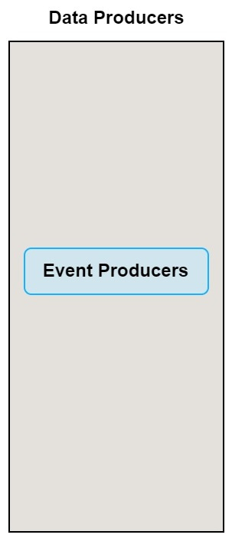
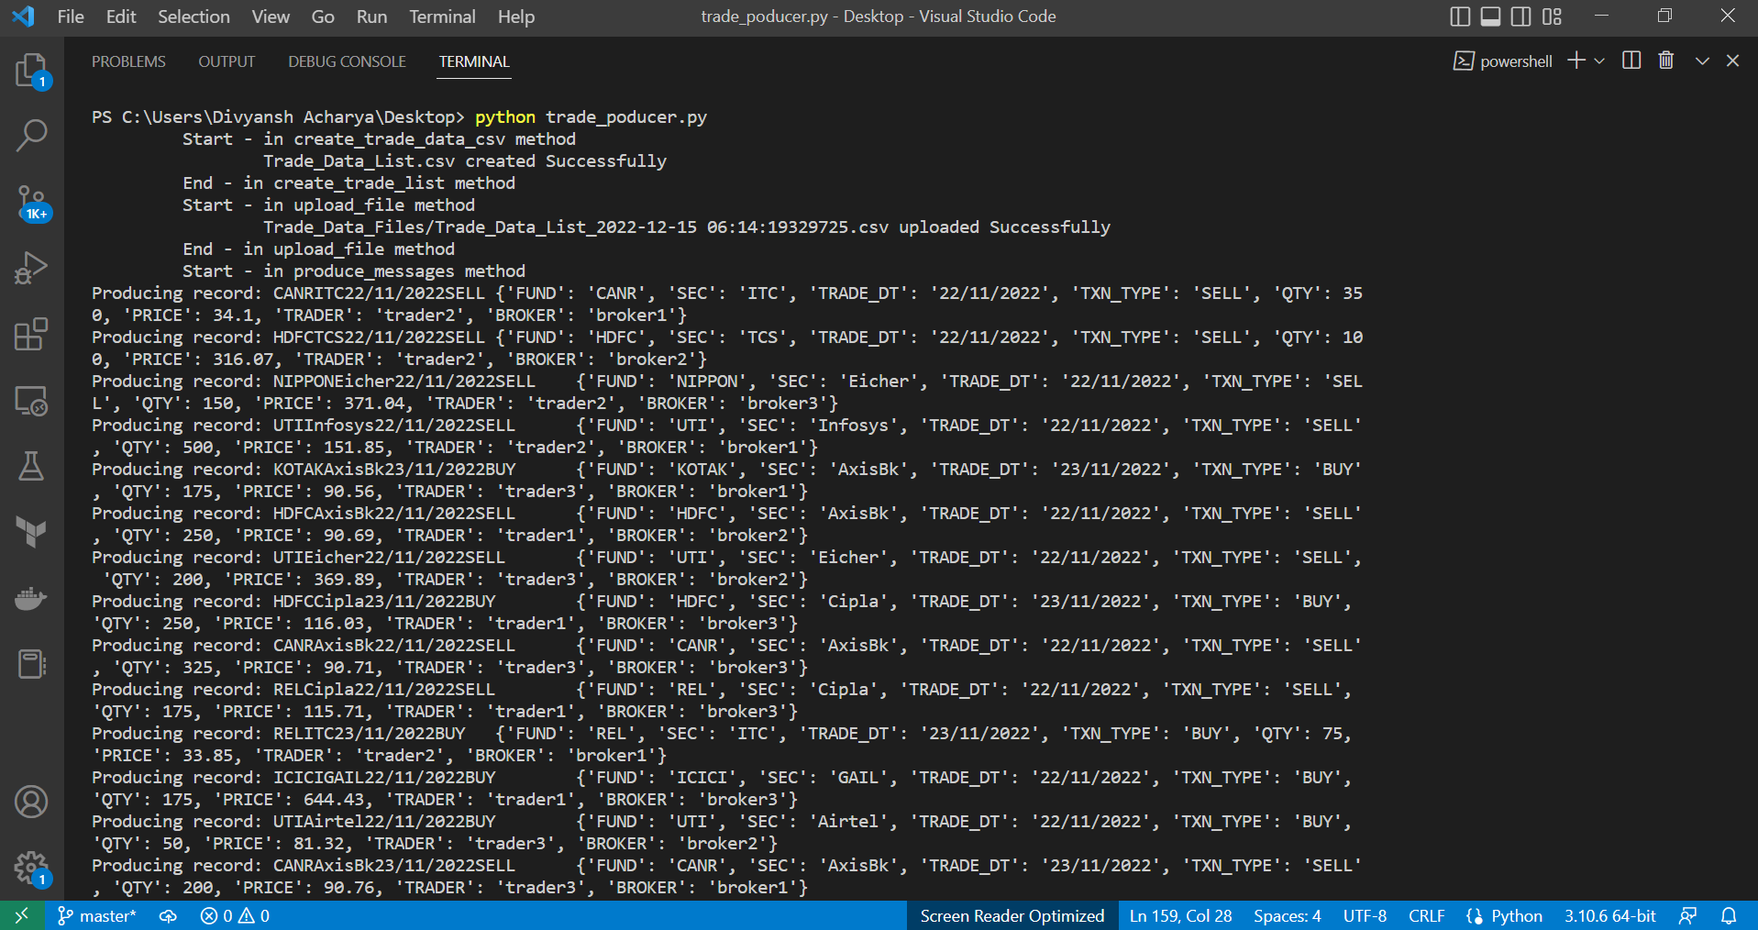
Data Producer – Trade Stream Producer

Slide 12
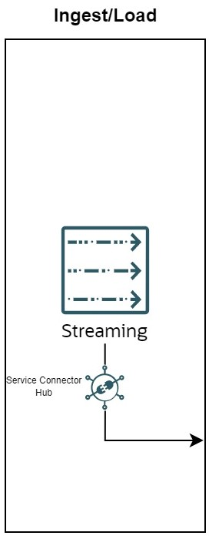
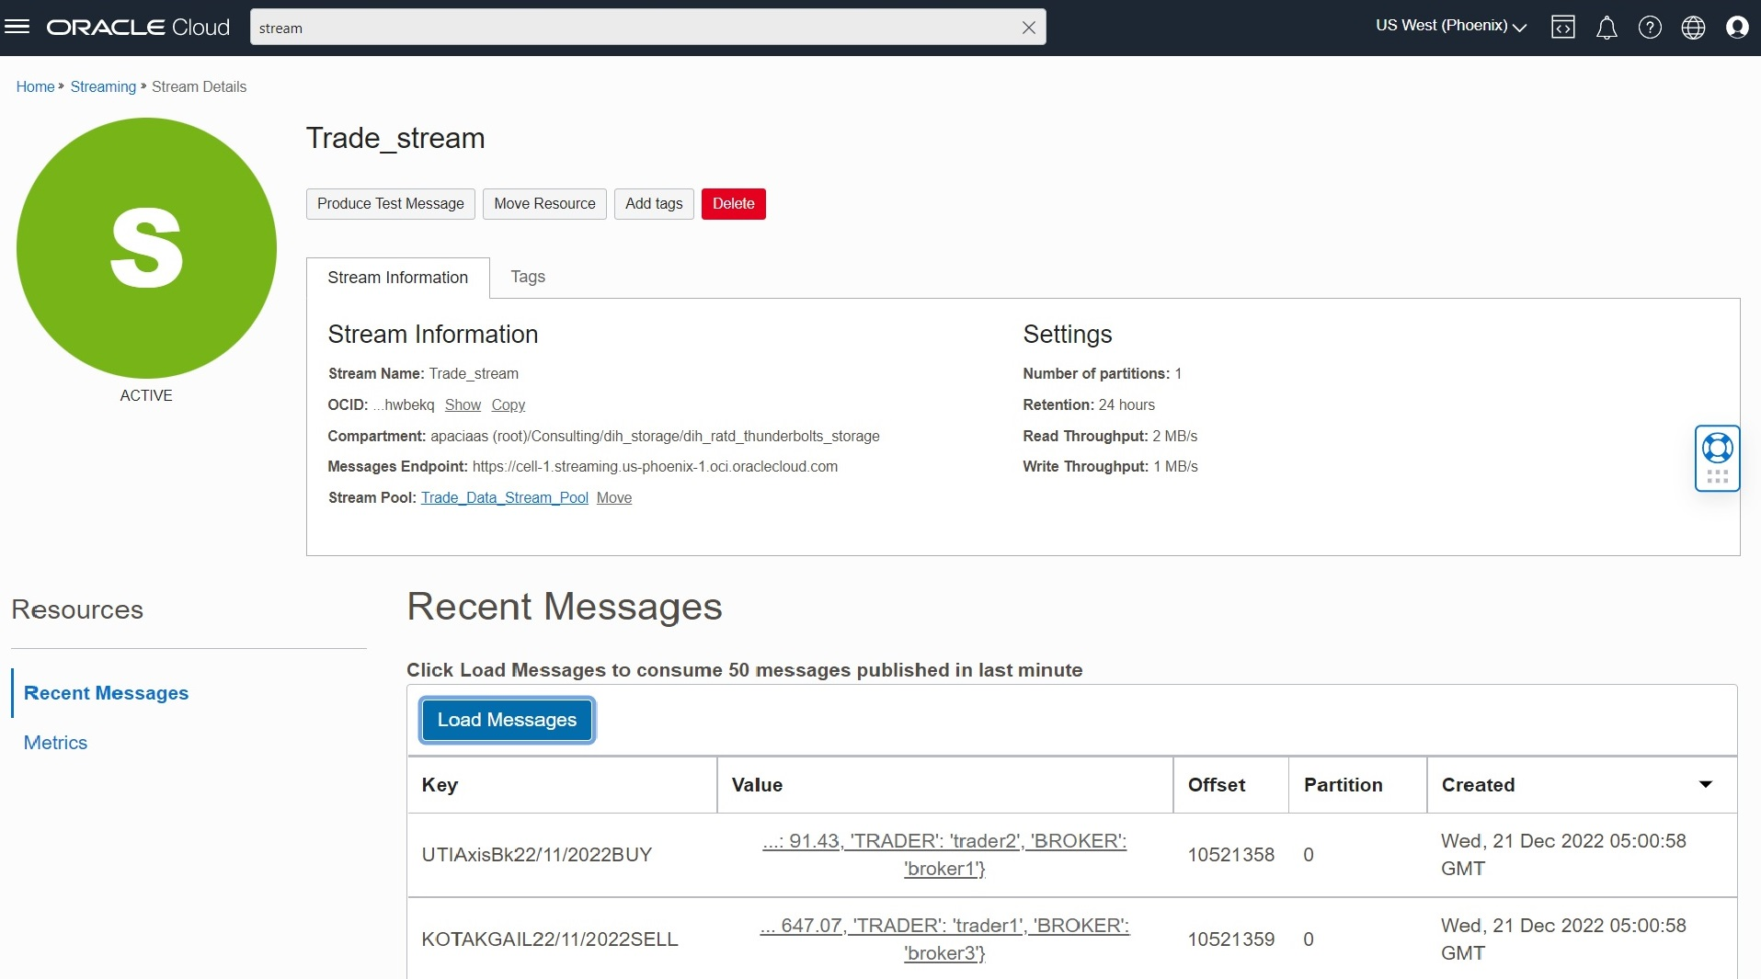
Ingest/Load- Data Stream Ingestion
Trades

Slide 13
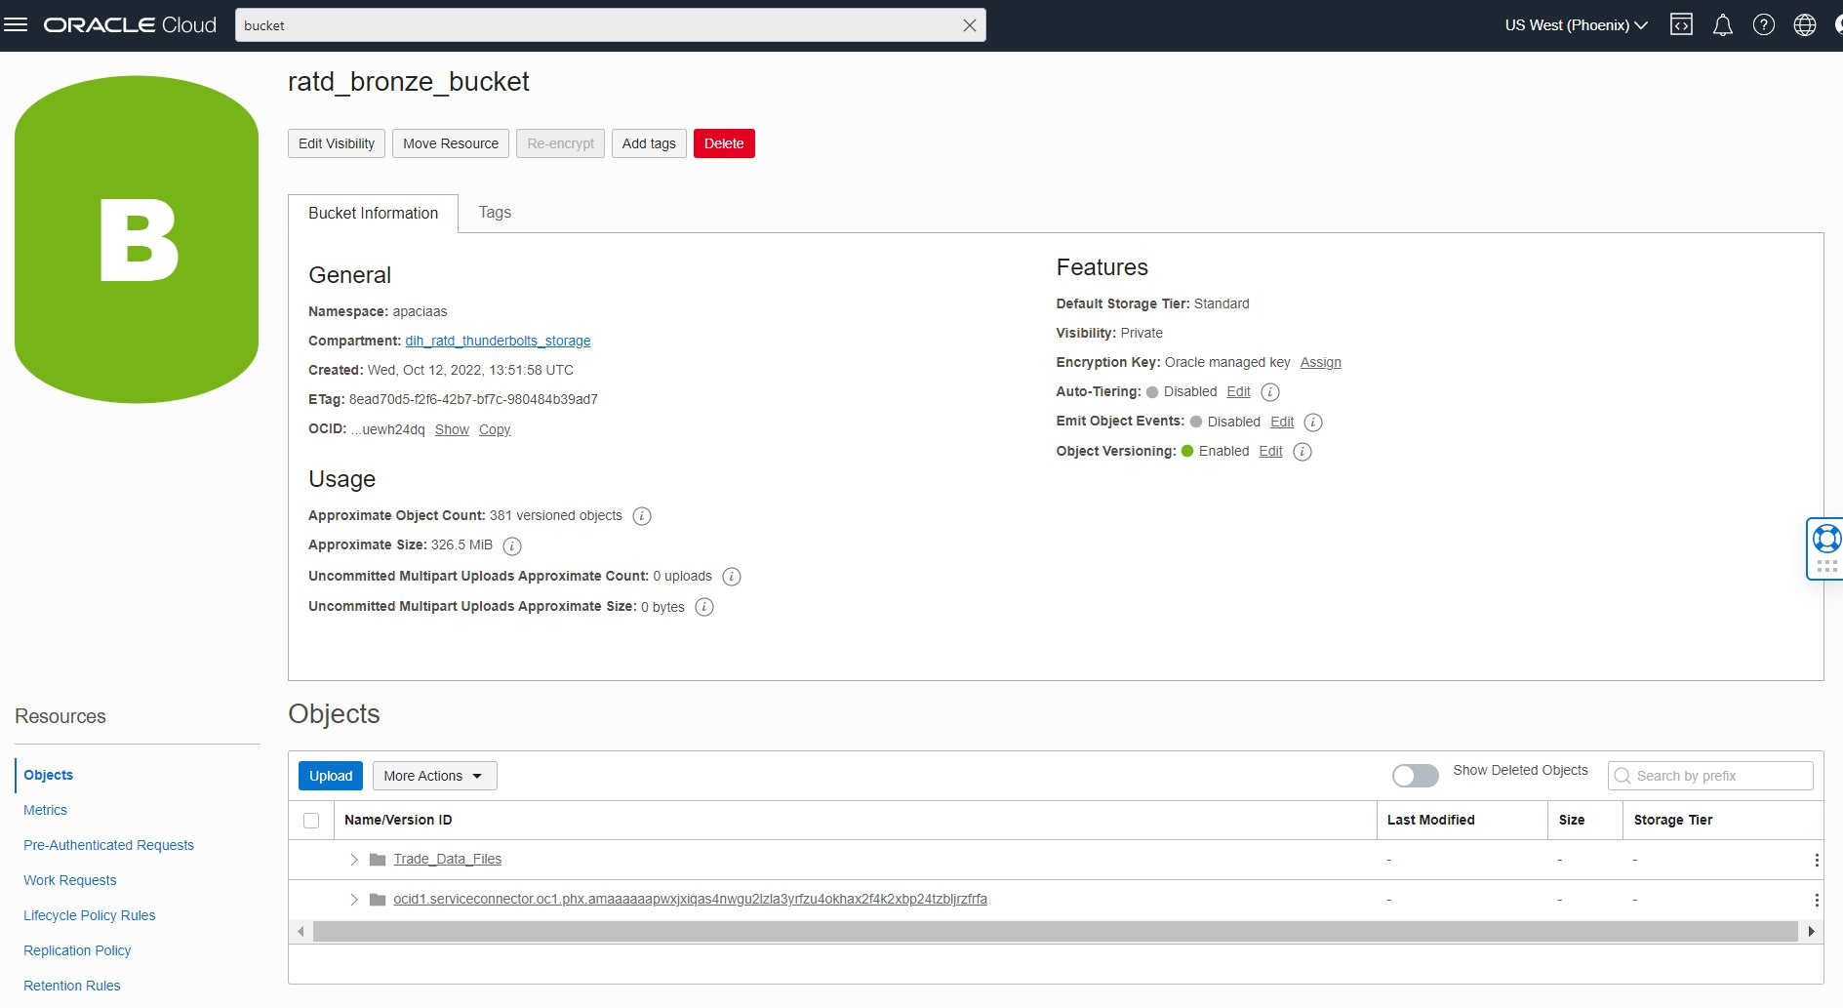
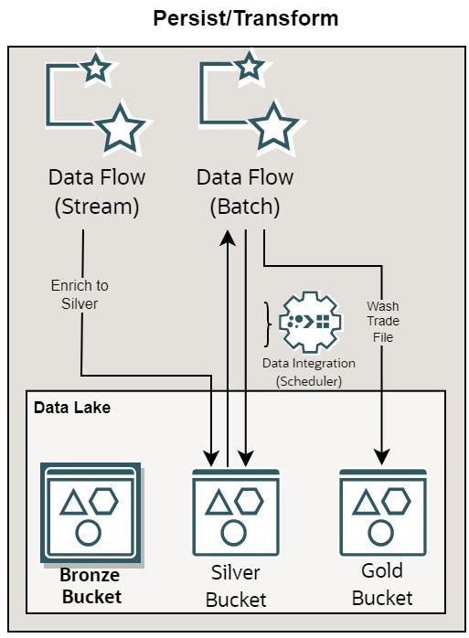
Persist/Transform - Bronze Bucket
Persist/Transform

Slide 14
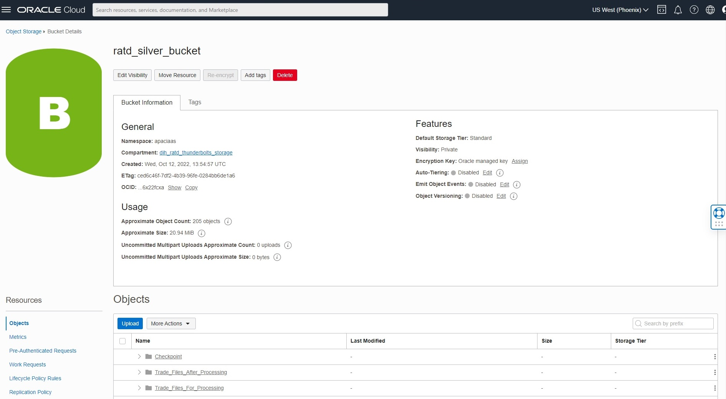
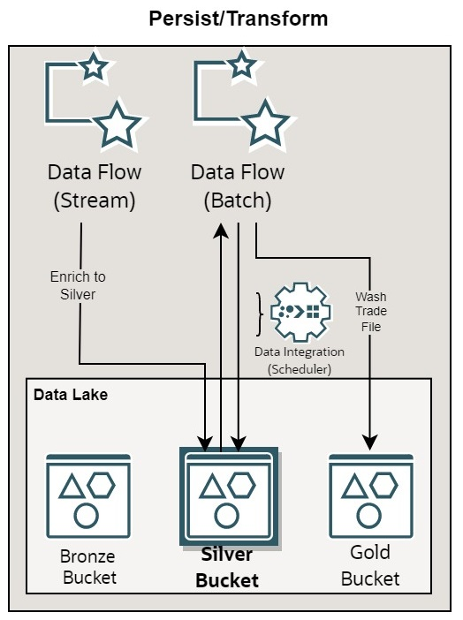
Persist/Transform - Silver Bucket
Persist/Transform

Slide 15
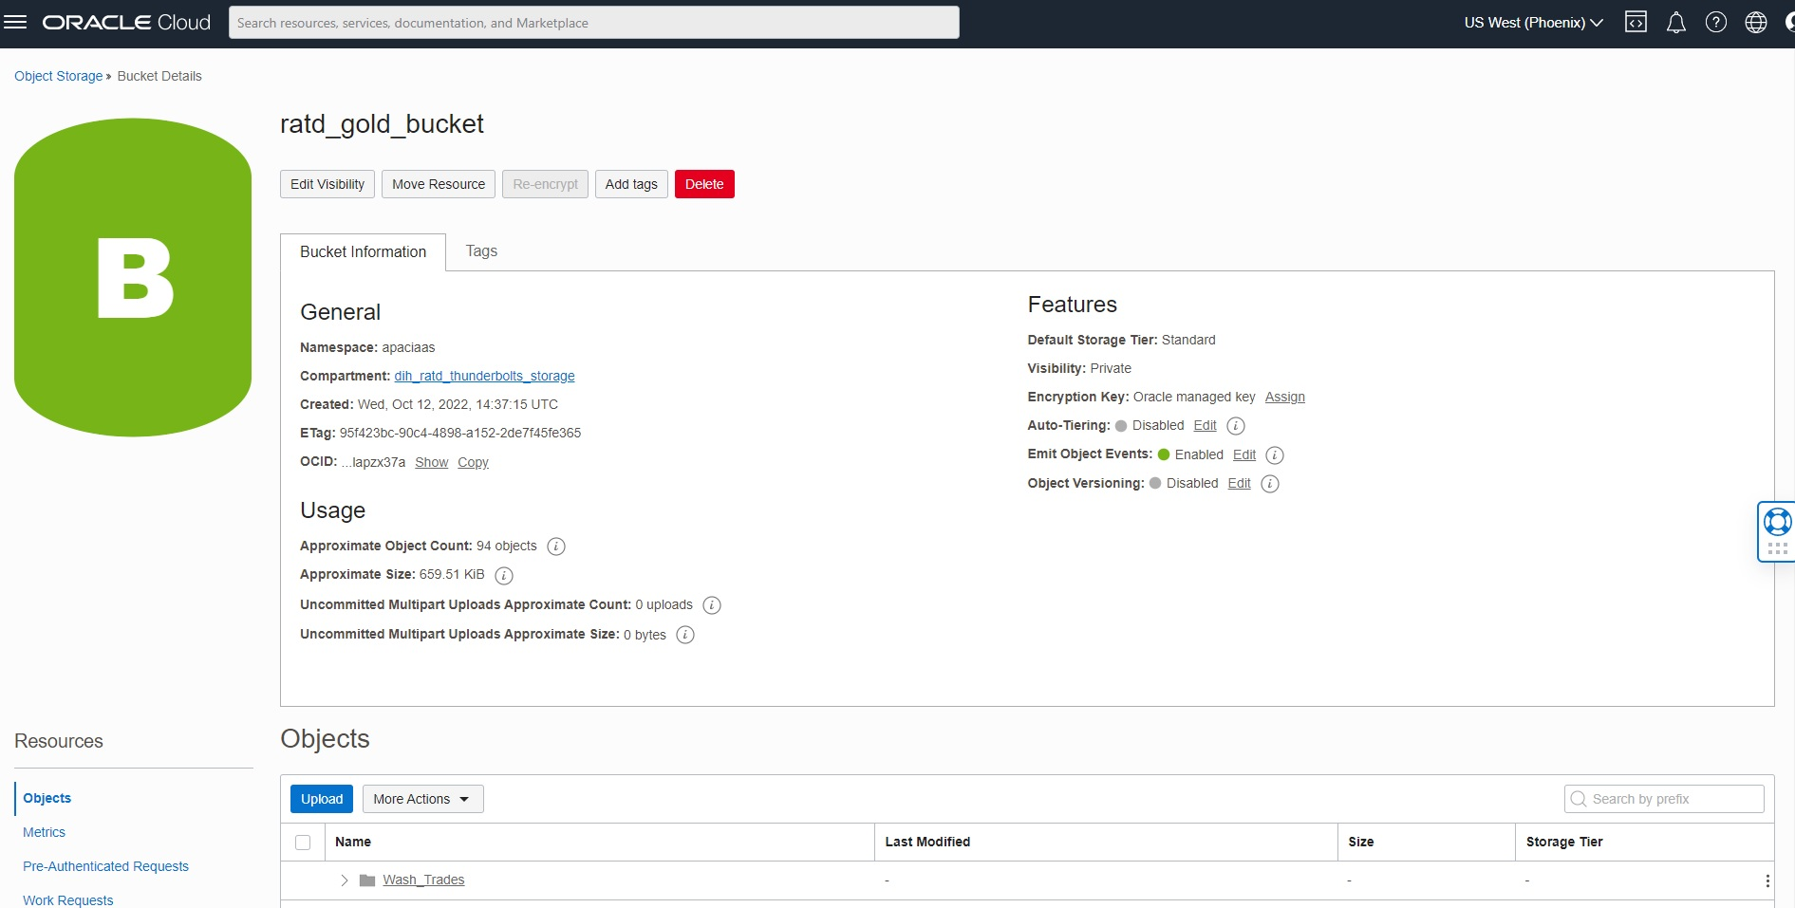
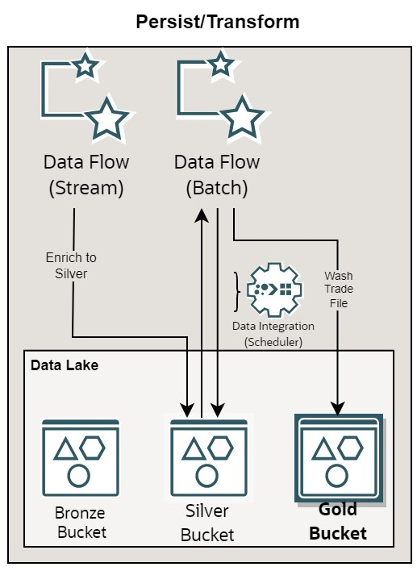
Persist/Transform - Gold Bucket
Persist/Transform

Slide 16
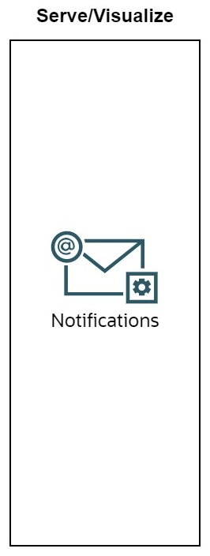
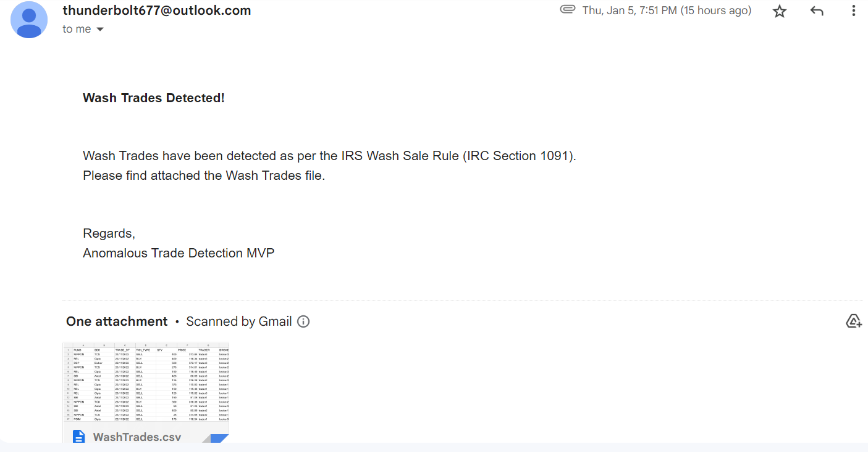
Serve/Visualize - Wash Trades Email

Slide 17
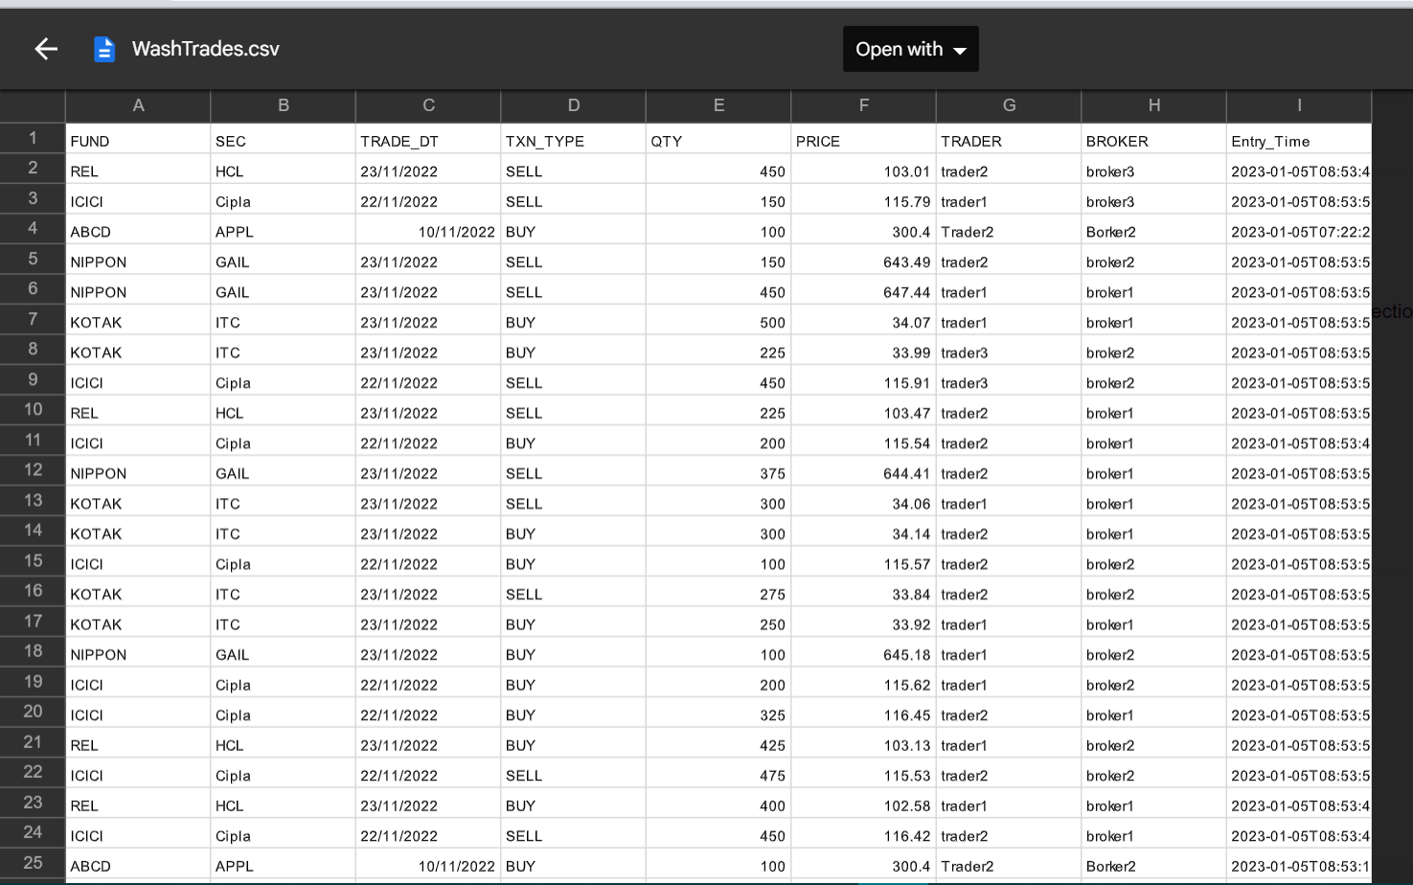
Serve/Visualize - Wash Trade CSV file

Slide 18
Thank You!

